Slide 1

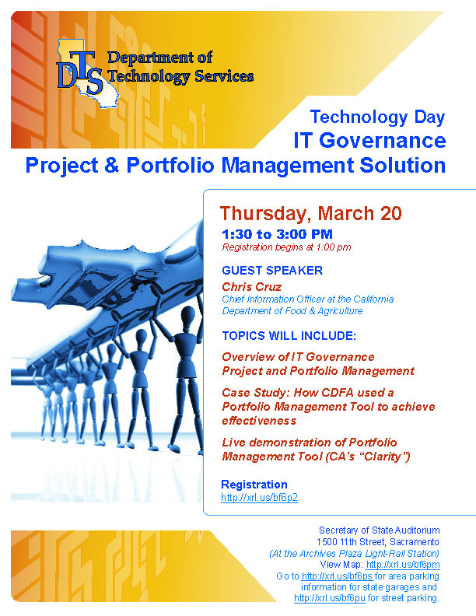
(INSERT EVENT FLYER)

Slide 2
Introduction
Welcome!
  Presentation Slides will be available on the DTS website soon.
  Please complete your Evaluation Surveys!
  Present your Case Study at a DTS Technology Day.

Slide 3
Upcoming DTS Events
Customer Forum:
DTS Service Delivery Improvement
  April 17
IT Security Forum - 2nd Quarter
Focus on DTS Media Handling Process
  April 30
Customer Forum:
DTS Annual Report to Customer at GTC
  May 14
Technology Day:
Shared Services – Gartner Analyst Andrea DiMaio
  June 3
Link to DTS Event Calendar: http://www.dts.ca.gov/calendar/default.asp

Slide 4

IT Governance Portfolio and Project Management in State Government
Chris Cruz, Chief Information Officer, California Department of Food and Agriculture

Slide 5
IT Governance and Project and Portfolio Management- Agenda
  Key Challenges in Today's Organizations
  IT Governance
  Portfolio and Project Management
  Handouts
  Q & A

Slide 6
Key Challenges in Today's Organizations
Providing executive staff with project health & resource requirements
Understanding the impact of new projects on the existing project queue
Providing improved resource allocation management
Collaboration and communication across and within project teams
Addressing the organizational change that is required to meet the vision of moving to the next level of project management
Answering “What’s in it for me?” for the project managers and team members who will be providing the data points to enable the solution
Are you doing the right things to feed your organizational strategy?

Slide 7
Roadmap to PM & IT Organizational Maturity
Enterprise
PPM is optimized across the enterprise with a focus on continuous risk mitigation and value creation
Project portfolio performance and risk data is understood and can be compared at the individual, cross-LOB, and enterprise levels
Senior leadership is able to leverage PPM analysis when allocating funds to various portfolios
Ability to measure and benchmark entire portfolio lifecycle
Our Opportunity
Cross
Portfolio
PPM is adopted and used consistently across multiple organizations and portfolios
Portfolio Analysts can compare and leverage portfolio analysis information across multiple departments
Consistent measures enable cross portfolio analysis, selection, planning and management that supports predictive modeling and internal / external benchmarking
Portfolio Value = Value Potential x Ability to Realize
Project
Portfolio
Portfolio analysis is repeatable, predictable, and consistently used to evaluate and optimize project portfolio selection
Portfolio Management teams are able to understand, analyze, & recommend optimal portfolio bundles and schedules to technology and business partners
Value to Organization
Project
Inventory
Processes are defined & documented, and most projects are aligned to Business Driver
All projects are consistently captured in a project inventory
Ad hoc
No Portfolio Inventory or Process
-“Just Do It/FIFO”
-Success is random
-Poor transparency
Basic
Stages of Excellence
World-Class
Crawl Walk Run

Slide 8
Key IT & PM Drivers & Questions
Key Drivers
Heavy demands on a limited staff
Projects competing for limited dollars
Demand for quantifiable performance measures and for quality service delivery
Project continuity through funding cycles
Key Questions
What is the best value for selected investments? How do you measure the value?
How do you ensure that investments are strategically aligned with business objectives? Strategic Priority? Fit?
How do you realign investments in response to changing external and internal conditions, new processes and business enablers?
How do you make Go/No Go decisions on projects?
How do you determine future/replacement investments?

Slide 9
What is IT Governance?
Fundamentally, IT Governance is concerned with two issues:
  IT’s delivery of value of the business to internal and external stakeholders
  Mitigation of risks to reduce the chances of failed IT projects
Sets strategic IT direction, provides leadership, supervises management, and reports to key stakeholders on the overall health and success of the IT department.
Includes those relationships between the department’s management, its governing body, and its other stakeholder community.
IT Governance areas include:
  Strategic alignment
  Value delivery
  Risk management
  Resource management
  Performance measurement

Slide 10
Define PMO Governance
Senior Management Support (Project Portfolio Management Office for Executive Sponsorship)
Define roles and responsibilities:
  Project Sponsor
  Project Managers
  Resource Managers
  Project Team Members
  Stakeholders
Define rules of engagement

Slide 11
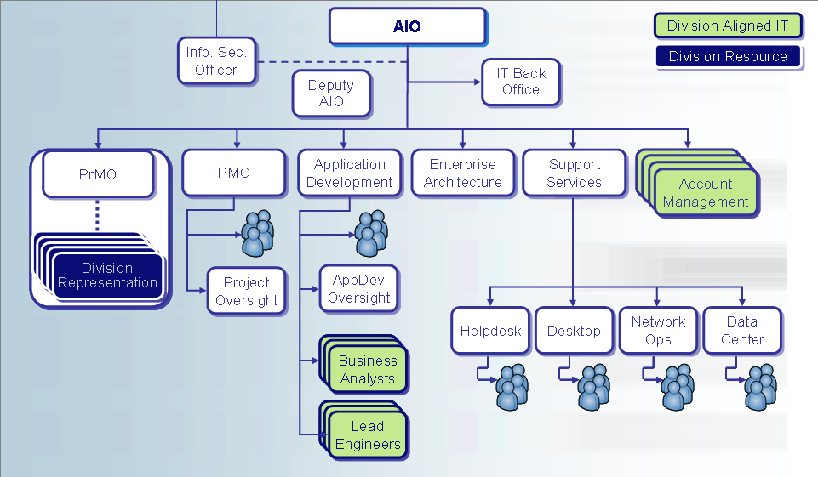
CDFA Placement of PrMO Organization
# Positions Needed
# Positions After Redirection
1
1
1
1
6
5
1
1
-
-
5
3
16
16
1
0
1
1
5
3
-
-
1
1
4
4
8
7
4
4
6
6
5
3
5
1

Slide 12
CDFA IT Governance Project Portfolio Approval Process
1
2
3
Business area develops IT project concept statement, submits to Division for approval
Division level approves concept statement, based on Governance Council guidelines, submits to AIO/CIO
AIO/CIO places project on Governance Council calendar
4
5
6
Governance Council reviews project statement, may solicit additional information from business group or Advisory Committee
Project statement forwarded to executive level for approval
Upon approval, FSR study team proceeds with study, completes FSR, ITPP and other required documents

Slide 13
CDFA IT Governance Project Overview Portfolio Management Clarity-Live Demonstration
Portfolio Manager Module
Project Management Module
Financial Management Module
Knowledge Store Module

Slide 14
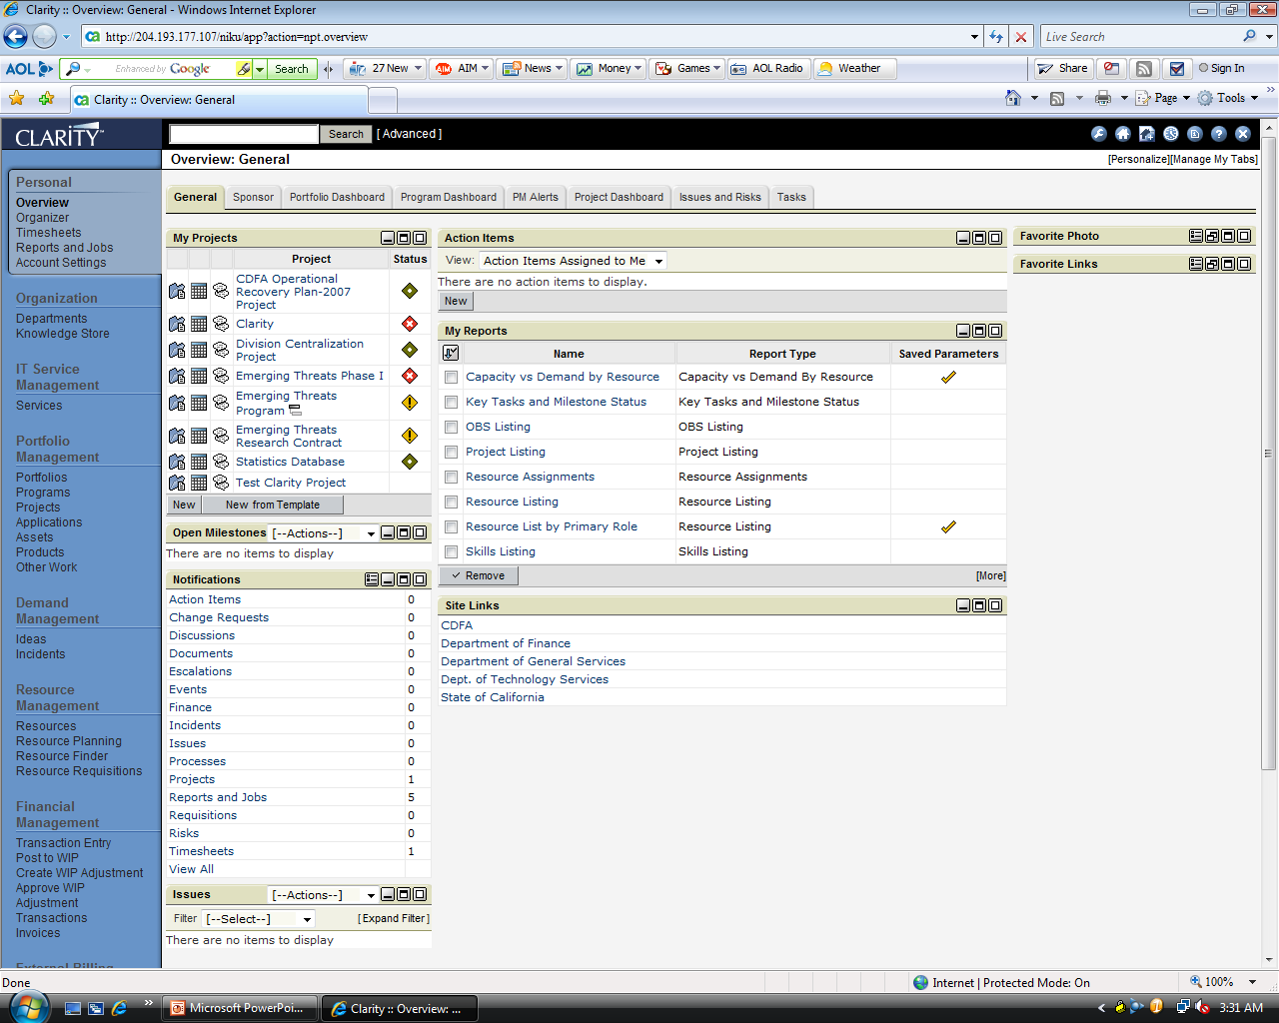
CDFA IT Governance Project Overview Portfolio Management Clarity

Slide 15
CDFA IT Governance Project Overview Portfolio Management Clarity

Slide 16
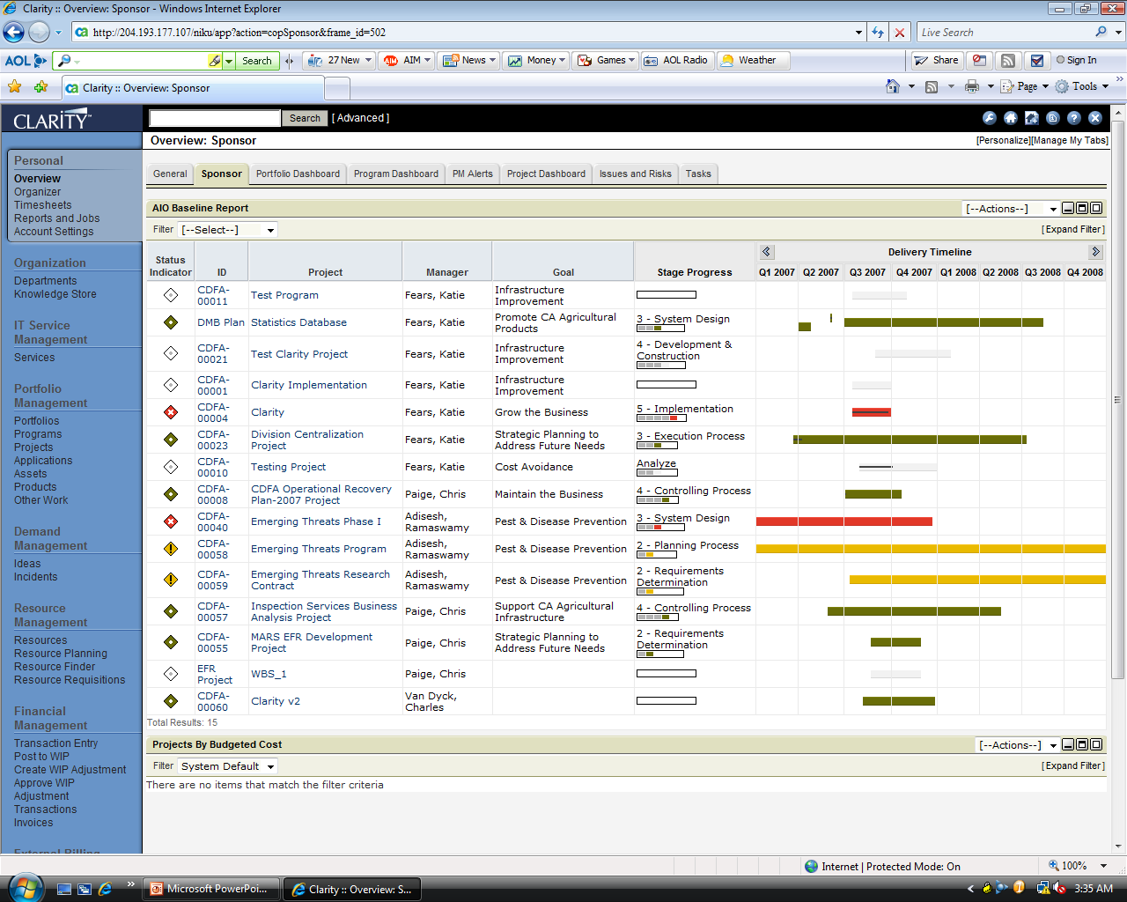
CDFA IT Portfolio Baseline Report

Slide 17
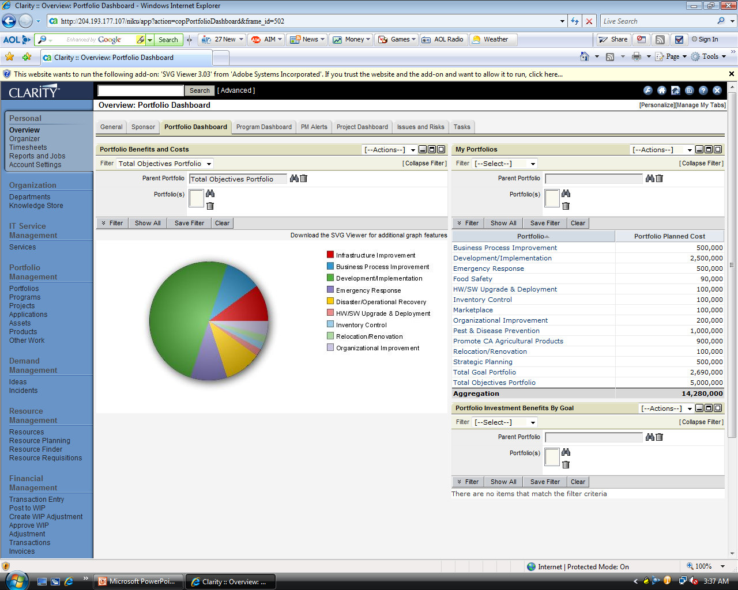
CDFA IT Portfolio Dashboard

Slide 18
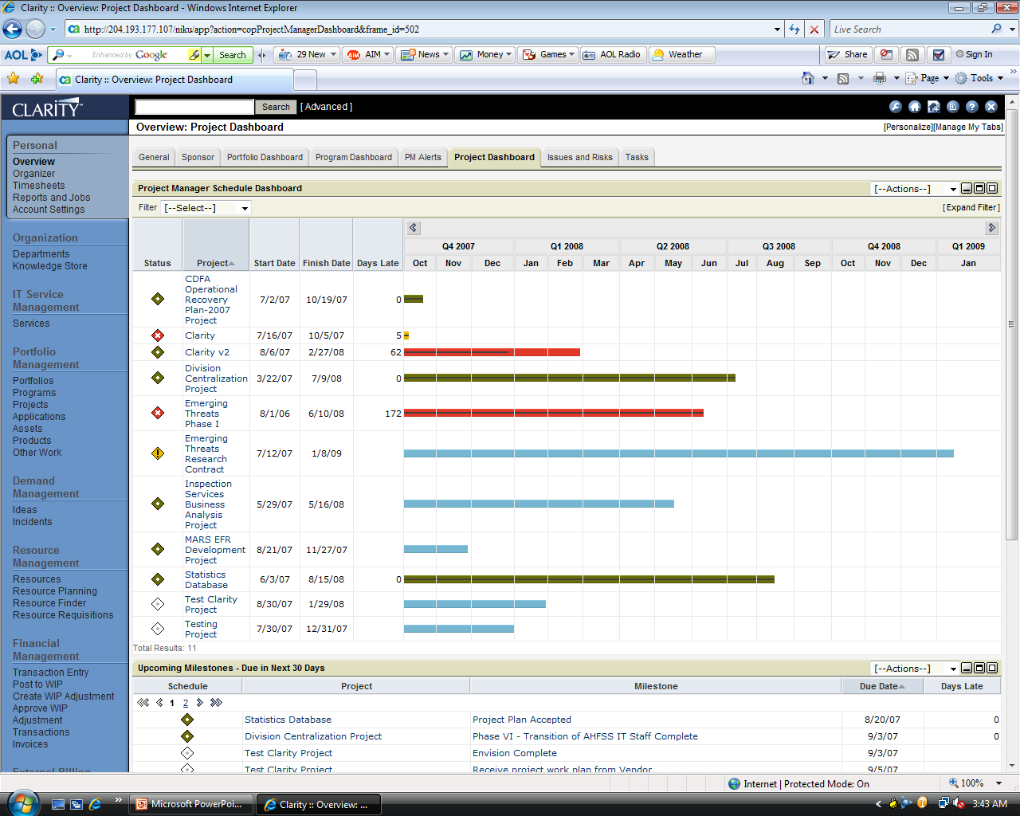
CDFA IT Project Dashboard

Slide 19
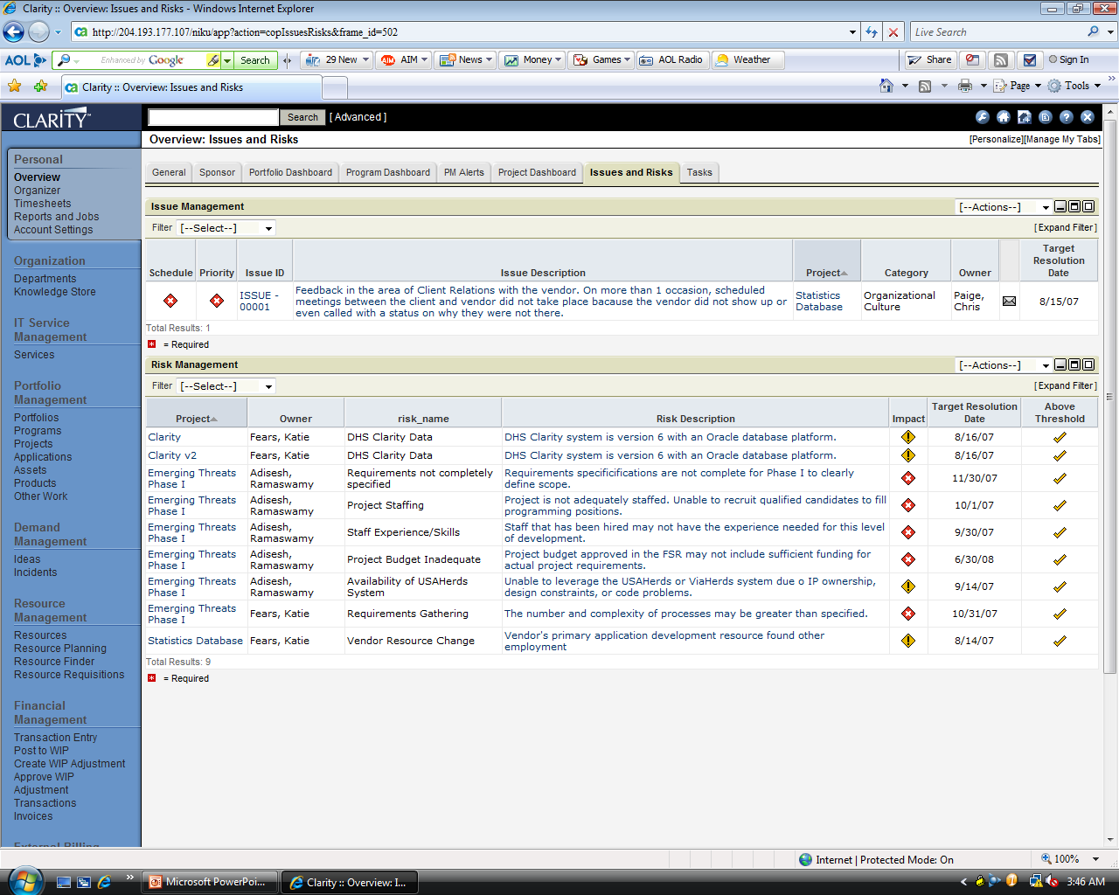
CDFA IT Project Issues and Risks

Slide 20
Lessons Learned
Allocate enough time to ensure the Configuration of the Clarity tool or any tool the you utilize meets your organizations specific needs
Develop project documentation that fits your configuration
Train your “Project Managers” early and train often so they buy into the tools that you select for Portfolio and Project Management
Allocate a dedicated staff resource to do the Database Administration and perform updates to the application

Slide 21
Handouts
Project Management Methodology
Project Lifecycle Documentation

Slide 22
Question and Answer Session
Q&A

Slide 23
Contact Information
Christopher Cruz
  ccruz@cdfa.ca.gov
  (916) 651-1030

